Slide 1
Understanding the CMS Emergency
Preparedness Rule

Slide 2


Agenda
Overview of the rule
Timeline
Audit and enforcement
CMS cost estimations
Resources
4

Slide 3
Overview: CMS Emergency Preparedness Rule

Slide 4



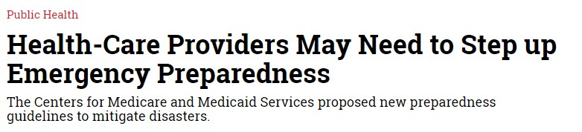


Origins of the rule
Longtime coming…
Call to action following 9/11, Hurricanes Katrina and Sandy, Ebola, Zika
  Breakdowns in patient care
  Inconsistent standards
  Inconsistent levels of preparedness
Debate on incentivizing vs. mandating preparedness

Slide 5

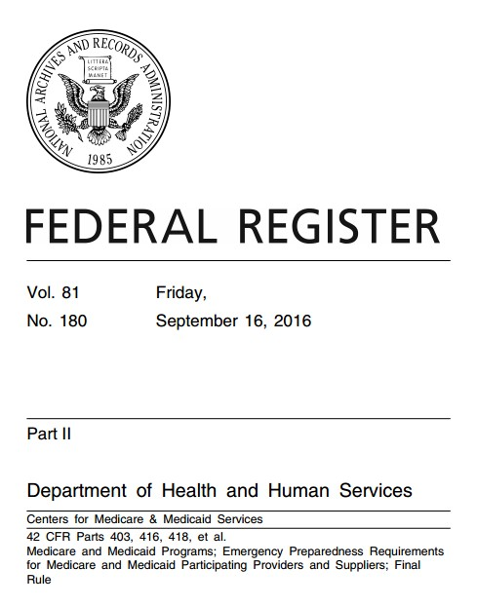
What it is
Purpose: To establish national emergency preparedness requirements, consistent across provider and supplier types.
Outlines emergency preparedness Conditions of Participation (CoPs) & Conditions for Coverage (CfCs)
  CoPs and CfCs are health and safety standards all participating providers must meet to receive certificate of compliance
Applies to 17 provider and supplier types
  Different emergency preparedness regulations for each provider type
Bottom line: Providers and Suppliers that wish to participate in Medicare and Medicaid – i.e. the nation’s largest insurer – must demonstrate they meet new emergency preparedness requirements in rule.

Slide 6
Who does it apply to?
Inpatient | Outpatient
Hospitals Critical Access Hospitals Religious Nonmedical Health Care Institutions (RNHCIs) Psychiatric Residential Treatment Facilities (PRTFs) Long-Term Care (LTC) / Skilled Nursing Facilities Intermediate Care Facilities for Individuals with Intellectual Disabilities (ICF/IID) | Ambulatory Surgical Centers Clinics, Rehabilitation Agencies, and Public Health Agencies as Providers of Outpatient Physical Therapy and Speech-Language Pathology Services Community Mental Health Centers (CMHCs) Comprehensive Outpatient Rehabilitation Facilities (CORFs) End-Stage Renal Disease (ESRD) Facilities Rural Health Clinics (RHCs) and Federally Qualified Health Centers (FQHCs) Home Health Agencies (HHAs) Hospice Organ Procurement Organizations (OPOs) Programs of All-Inclusive Care for the Elderly (PACE) Transplant Centers

Slide 7




Four core elements
Emergency Plan
Based on a risk assessment
Using an all- hazards approach
Policies & Procedures
Based on risk assessment and emergency plan
Must address: subsistence of staff and patients, evacuation, sheltering in place, tracking patients and staff
Communications Plan
Complies with Federal and State laws
Training & Exercise Program
Develop training program, including initial training on policies & procedures
Coordinate patient care within facility, across providers,
and with state and local public health and emergency management
Update plan
annually
Conduct drills and exercises

Slide 8
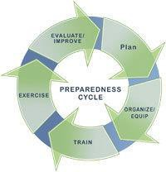
Risk Assessment and Emergency Plan
Perform a risk assessment using an “all-hazards” approach
Develop an emergency plan based on the risk assessment
Update emergency plan at least annually

Slide 9

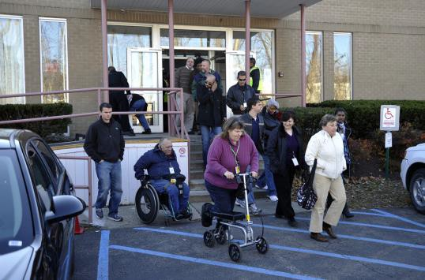
Policies and Procedures
Develop and implement policies and procedures based on the emergency plan, risk assessment, and communication plan
Policies and procedures must address a range of issues including:
  Subsistence needs,
  Evacuation and shelter in place plans,
  Tracking patients and staff during an emergency,
  Medical documentation, and;
  Processes to develop arrangements with other providers/suppliers.
Review and update policies and procedures at least annually

Slide 10
Communication Plan
Develop a communication plan that complies with both Federal and State laws
Coordinate patient care within the facility, across healthcare providers, and with state and local public health departments and emergency management systems. To include:
  Contact information for staff, entities providing services under other arrangements, patients’ physicians, other hospitals, and volunteers
  Maintaining contact info for regional or local emergency preparedness agencies
  A means, in the event of evacuation, to release patient information
Review and update plan annually

Slide 11



Training and Testing Program
Develop and maintain training and testing programs. To include:
  Initial training on emergency preparedness policies and
procedures.
  Training to all new and existing staff, including volunteers and maintain documentation of training.
Demonstrate staff knowledge of emergency procedures and provide training at least annually
Conduct drills and exercises to test the emergency plan
– Hospitals and most other provides must conduct one full-scale exercise annually and an additional exercise of the facility’s choice.

Slide 12
Other key elements
Emergency and Standby Power
Higher level of requirements for hospitals, critical access hospitals, and long-term care facilities.
Locate generators in accordance with National Fire Protection Association (NFPA) guidelines.
Conduct generator testing, inspection, and maintenance as required by NFPA.
Maintain sufficient fuel to sustain power during an emergency.
Evacuation
Home health agencies and hospices must inform officials of patients in need of evacuation.
Emergency Plans
Long-term care and psychiatric residential treatment facilities must share information on emergency plan with patient family members or representatives.

Slide 13

Implementation timeline
2016
September 15 – Rule published
November 15 – Rule goes into effect
2017
Late winter/ spring – Interpretive Guidance
released
November 15 – Rule must be implemented

Slide 14

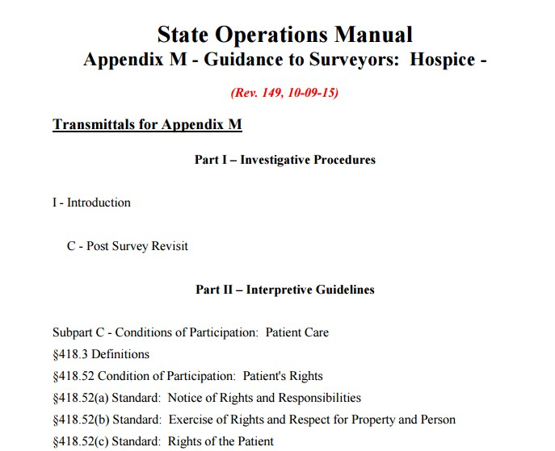
Interpretive guidelines
Survey and Certification Group (SCG) is currently developing Interpretive Guidelines (IGs)
  State surveyors will use the IGs and survey procedures in the State Operations Manual to assist in implementing the rule
  Anticipated release of IGs is Spring 2017
IGs will be formatted into one appendix in the State Operations Manual

Slide 15

Auditing and enforcement
How will rule be audited?
Compliance monitoring
State Survey Agencies (SSAs)
Use IGs and State Operations Manual
Accreditation Organizations (AOs)
CMS Regional Offices (ROs)
Checklists for surveyors and State Agencies, as well as for impacted providers and suppliers are in development.
SCG developing web-based training for surveyors and providers and suppliers .
Consequence for not complying?
Same process for other CoPs and CfCs → termination of agreement with Medicare & Medicaid.

Slide 16

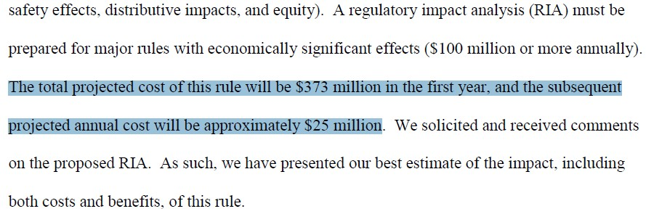
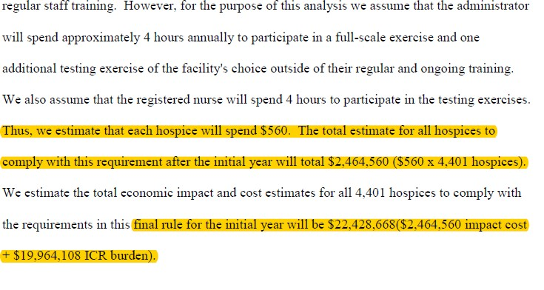
Costs of implementation
CMS predictions:
$373 million in first year
$25 million/year after
72,315 providers & suppliers impacted
How did CMS arrive at these numbers?
Took salaries of impacted employees x hours involved in compliance x number of facilities
Example: Hospice

Slide 17
Costs of implementation
If government is not providing funding for compliance, how are facilities expected to meet rule requirements?

Slide 18
Role of healthcare coalitions
One place to start – Healthcare Coalitions!
Rule offers HCCs great opportunity to support members and engage new providers.
Source of preparedness expertise
Regional risk assessments and hazard vulnerabilities Provide template or example plans and policies Help close planning gaps
Plan integration with healthcare facilities and local authorities Training and exercises

Slide 19
Resources

Slide 20

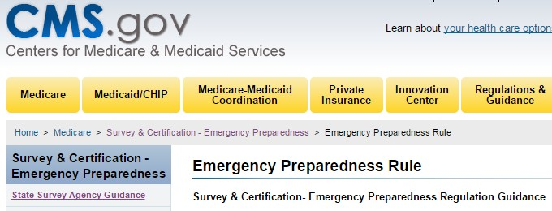


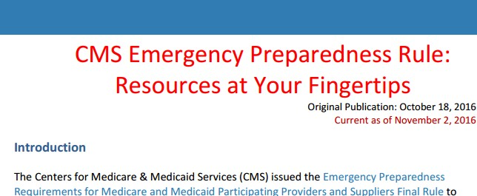
Resources
CMS Website
Outline of requirements by provider type
Links to aggregated EP resources
Routinely updated Frequently Asked Questions document
https://www.cms.gov/Medicare/Provider-Enrollment-and- Certification/SurveyCertEmergPrep/Emergency-Prep-Rule.html
HHS/ASPR Technical Resources, Assistance Center, and Information Exchange (TRACIE)
Web-based resource for healthcare stakeholders
Topic Collections
− General Emergency Management & Provider- and Supplier- Specific
Routinely updated CMS Resources at Your Fingertips
Submit technical assistance requests https://asprtracie.hhs.gov/cmsrule

Slide 21
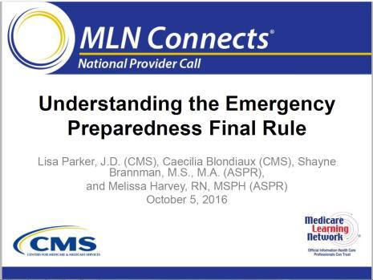
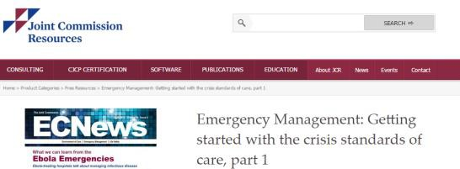
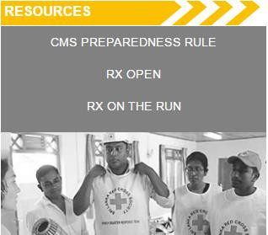
Resources cont.
CMS Webinar
Webinar hosted by CMS on the rule in October
Slides, transcript, and audio recording posted online
Federal & Accrediting Organizations Resources
Joint Commission
  Emergency Management Portal
FEMA Emergency Management Institute
  Independent Study online courses
Healthcare Ready CMS Knowledge Center
All resources above in one place
Running list of relevant articles
Perspectives from healthcare coalitions

Slide 22













Specific considerations - inpatient
Hospitals |  | Annual full-scale exercise and additional exercise of facility’s choice
Critical Access Hospital |  | Annual full-scale exercise and additional exercise of facility’s choice
Long-term Care |  | Share emergency plan information with resident, family of resident, and other appropriate representatives
Psychiatric Residential Treatment Facilities (PRTFs) |  | Tracking applies both during and after to on- duty staff and sheltered residents
Intermediate Care Facilities for Individuals with Intellectual Disabilities (ICF/IID) |  | Tracking applies both during and after to on- duty staff and sheltered residents and must share emergency plan with patient’s families
Religious Nonmedical Health Care Institutions (RNHCIs) |  | No requirement to conduct drills
Transplant Center |  | Maintain agreements with organ procurement orgs

Slide 23
Thank you!
Questions?

