Slide 1
Arkansas Department of Health: Healthcare Preparedness Program
Presented by:
Alyce Wagner & Kristin Bendele
ADH Trauma, Preparedness, & EMS Branch

Slide 2
Hospital Preparedness Program
Began 2002
Arkansas Department of Health
Arkansas Hospital Association
Creation of 7 Hospital Preparedness Regions: Northwest, North Central, Northeast, Arkansas Valley, Metro, Southwest, Southeast
Now Healthcare Coalitions
2 Co-Leaders & Secretary
Notes:
AHCA aligned the Long Term Care Districts to geographically match the Hospital regions.

Slide 3
Healthcare Coalitions
Basis from 7 Hospital Regions
Collaboration of agencies, organizations, etc.
Healthcare
Emergency Managers
Long Term Care Facilities
EMS
Coroners
Law Enforcement
Notes:
Federal guidelines push towards HCC’s.
Explain HCC.
New CMS providers
Funding Sources

Slide 4
Healthcare Preparedness Program
Historically has been hospital centric.
Name-change recognition from “Hospital” to “Healthcare” Preparedness Program.
Coalitions are reaching out for non-hospital partners to be more community centric.

Slide 5
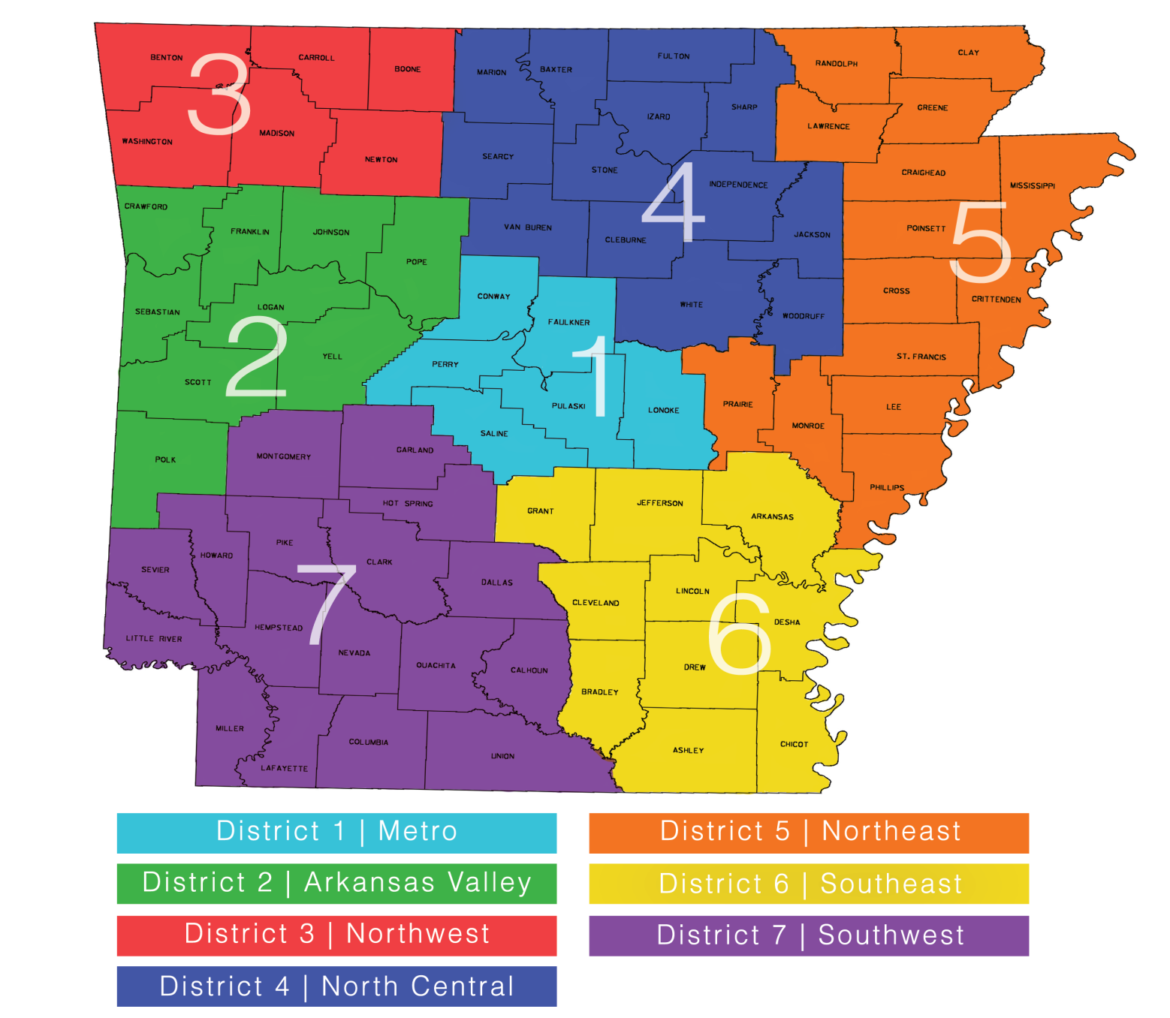

Slide 6
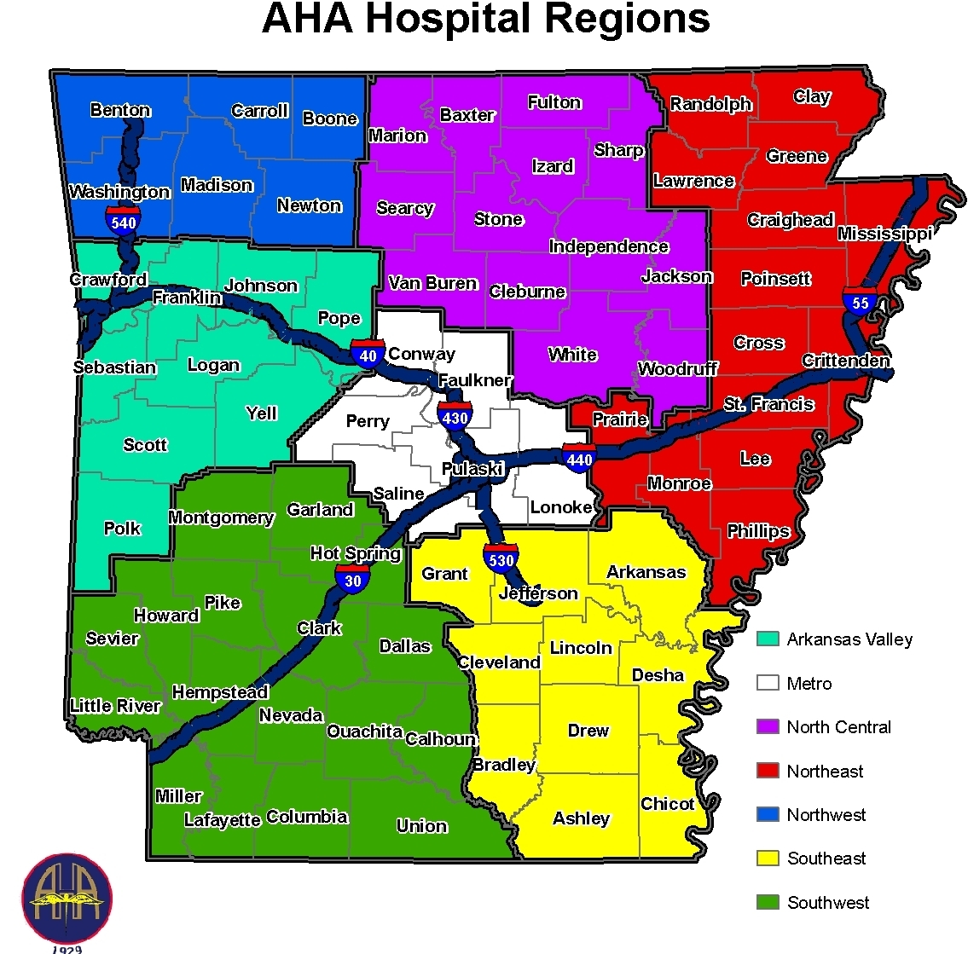

Slide 7
Questions??
Alyce Wagner
Preparedness and Emergency Response
Arkansas Department of Health
501-580-4174
Alyce.Wagner@arkansas.gov
Kristin Bendele
HPP/HAN Coordinator
Preparedness & Emergency Response Branch
Arkansas Department of Health
501-671-1536
Kristin.Bendele@arkansas.gov
Funding for this conference was made possible (in part) by the Centers for Disease Control and Prevention. The views expressed in written conference materials or publications and by speakers and moderators do not necessarily reflect the official policies of the Department of Health and Human Services, nor does the mention of trade names, commercial practices, or organizations imply endorsement by the U.S. Government.

